Slide 1


Slide 2



This course material by Osama Salah is released under the following license:
Attribution-ShareAlike 4.0 International (CC BY-SA 4.0)
Conditions for use are published here:
https://creativecommons.org/licenses/by-sa/4.0/

Slide 3
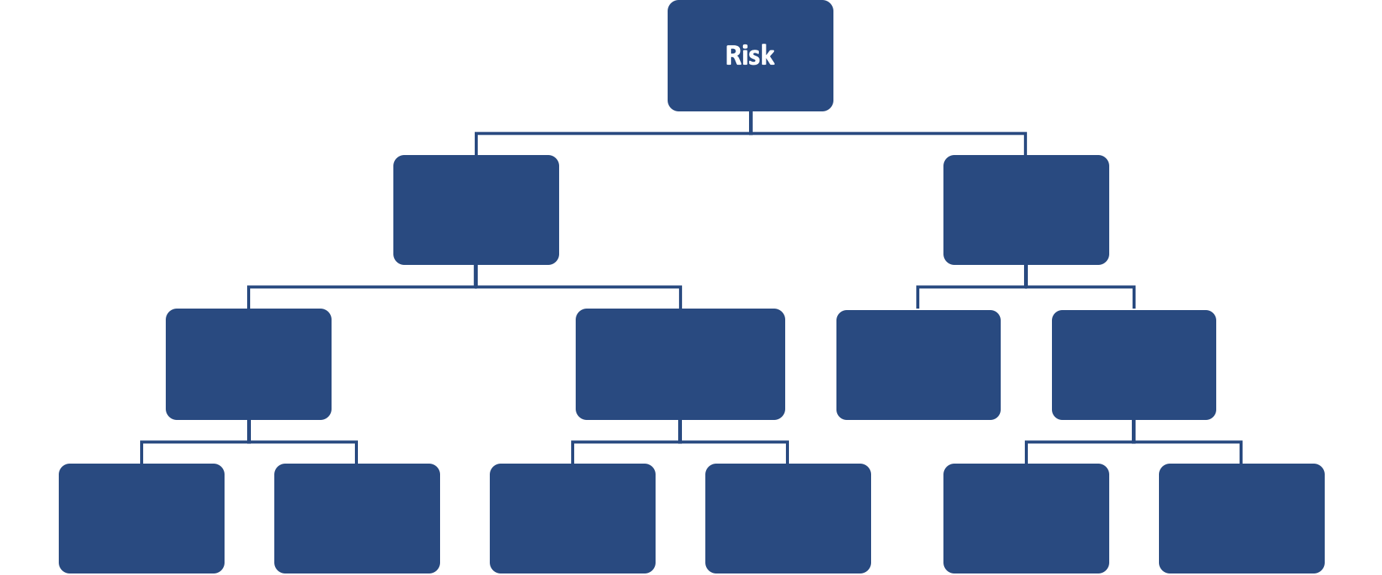
FAIR Open Course Module 2 - The FAIR Model Ver. 0.1 / Last Update: 14/09/2019

Slide 4
The FAIR Model
$
Risk
Loss Event Frequency
Threat Event Frequency
Vulnerability
Loss Magnitude
Primary Loss
Secondary Risk
Secondary Loss Event Frequency
Secondary Loss Magnitude
Contact Frequency
Probability of Action
Threat Capability
Resistance Strength
#
$
#
%
$
$
#
%
%
%
%
$

Slide 5
The FAIR Model
Note: In a risk analysis we only go as deep into the model as is needed or supported by good data.
If we go deeper into the model and start using even more uncertain estimates or data we risk reducing the accuracy of the analysis.
Even if some building blocks are not used in a risk analysis it is good to keep them in mind and review how they might relate to the scenario. This review might reveal other aspects of the scenario (scope, assumptions etc.) that were previously not specifically mentioned.

Slide 6
Risk
Loss Event Frequency
Threat Event Frequency
Vulnerability
Loss Magnitude
Primary Loss
Secondary Risk
Secondary Loss Event Frequency
Secondary Loss Magnitude
Contact Frequency
Probability of Action
Threat Capability
Resistance Strength

Slide 7
Risk
Risk
Loss Event Frequency
Loss Magnitude
“The probable frequency and probable magnitude of future loss.”
Probability based (due to imperfect data, models and future uncertainty)
Informs decision makers on the future potential for loss.
Notes:
Note that the model shows a relationship between the building blocks. For example here it shows that risk is a function of LEF and LM. It should not be assumed that the function is a simple multiplication or some other mathematical operation. While some some functions are straight forward other might be more complicated in terms of implementation. However since we use tools (computational engine) we thankfully don’t have to worry about that.

Slide 8
Are these Risks?
Risks?
Cloud Computing | Technology
Insider Threat | Threat agent
Network share containing sensitive information | Assets
Mobile malware | Attack vector
Social engineering/phishing | Form of attack, technique
Organized crime | Threat agent
State sponsored attacks | Form of attack
Hacktivists | Threat agent
Ransomware | Attack vector
Internet of Things | Technology
Insecure Passwords | Deficient Control

Slide 9
Are these Risks?
Risks?
Cloud Computing
Insider Threat
Network share containing sensitive information
Mobile malware
Social engineering/phishing
Organized crime
State sponsored attacks
Hacktivists
Ransomware
Internet of Things
Insecure Passwords
None of these are risks. Remember, risk is defined as:
The probable frequency and probable magnitude of future loss.
There is no expression (direct, indirect or implied) of the frequency of something happening nor the probable magnitude of future loss.

Slide 10
How does your risk register compare?
We defined risk as “The probable frequency and probable magnitude of future loss.”
Instead of just “risk” think of a “risk event”
Such an event typically has three components:
Asset
Threat
Impact (CIA)

Slide 11
How does your risk register compare?
A typical mistake is to list a control deficiency or variance as a risk.
For Example: “Irregular movement of backup tapes to off-site location could lead to data loss.”
Moving tapes off-site is a control you have implemented (through a policy or procedure) to address the risk of data loss to destruction of tapes in case of a disaster in the primary location.
Your control is not working as expected. You address that through a security action, issue, assigning a task to someone etc. but not through recording a task.

Slide 12
How does your risk register compare?
?
So, how does your risk register compare?
Are your records reflecting actual risks?

Slide 13


A note on positive and negative risk
According to ISO 31000, risk is “the effect of uncertainty on objectives”
ISO 31000 considers effect as a positive or negative deviation from what is expected. Thus risk can be positive or negative.
According to FAIR, risk is “The probable frequency and probable magnitude of future loss.”
FAIR focuses on “loss” or the negative side only.
!
There is an ongoing debate on this subject that we will not get into. Research it on your own if you find it of interest.

Slide 14
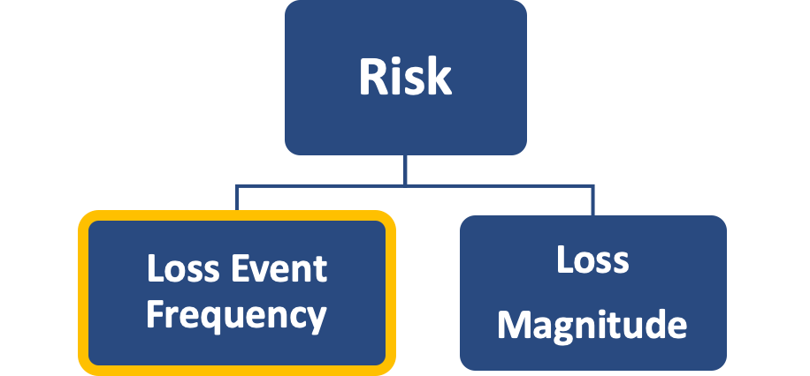
Loss Event Frequency (LEF)
“The probable frequency, within a given time-frame, that loss will materialize from a threat-agent’s action.”
A measure of how often loss is likely to happen.
There must be a time-frame reference. Given no-time framing, almost any event is possible.
Typically expressed as a distribution using annualized values.
For example: Between 5 to 25 times per year, with the most likely frequency of 10 times per year.
Expressed as probability if it happens only once.
Min | Most Likely | Max
5 | 10 | 25
Notes:
Frequencies are much easier to understand by everyone in contrast to probabilities. They also force you to mention a time frame.
For example we tend to say something like “It has a probability of 0.2”. What does that exactly mean?
I contrast when we say “This might happen twice every 10 years” it is very clear to everyone what exactly we mean.

Slide 15
Loss Event Frequency (LEF)
FAIR uses frequencies instead of probabilities or “likelihood” (unless we are talking about a single event like the moon exploding etc.)
Frequencies are easier to understand and force us to define a time-frame.
For example you might have heard in a risk analysis workshop someone saying ”This has a probability of 0.2”. But what does that mean?
In contrast “This could happen twice in 10 years” (or once in five years) is significantly clearer to everyone. There is a clear reference class mentioned.
Gerd Gigerenzer also recommends using frequencies.
Book recommendation: Gerd Gigerenzer, Risk Savvy: How to Make Good Decisions.
Notes:
Frequencies are much easier to understand by everyone in contrast to probabilities. They also force you to mention a time frame.
For example we tend to say something like “It has a probability of 0.2”. What does that exactly mean?
I contrast when we say “This might happen twice every 10 years” it is very clear to everyone what exactly we mean.

Slide 16
Threat Event Frequency (TEF)
Risk
Loss Event Frequency
Threat Event Frequency
Vulnerability
Loss Magnitude
Primary Loss
Secondary Risk
Secondary Loss Event Frequency
Secondary Loss Magnitude
Contact Frequency
Probability of Action
Threat Capability
Resistance Strength
Notes:
What can we infer by just looking at the model?
LEF is a function of TEF and Vulnerability

Slide 17
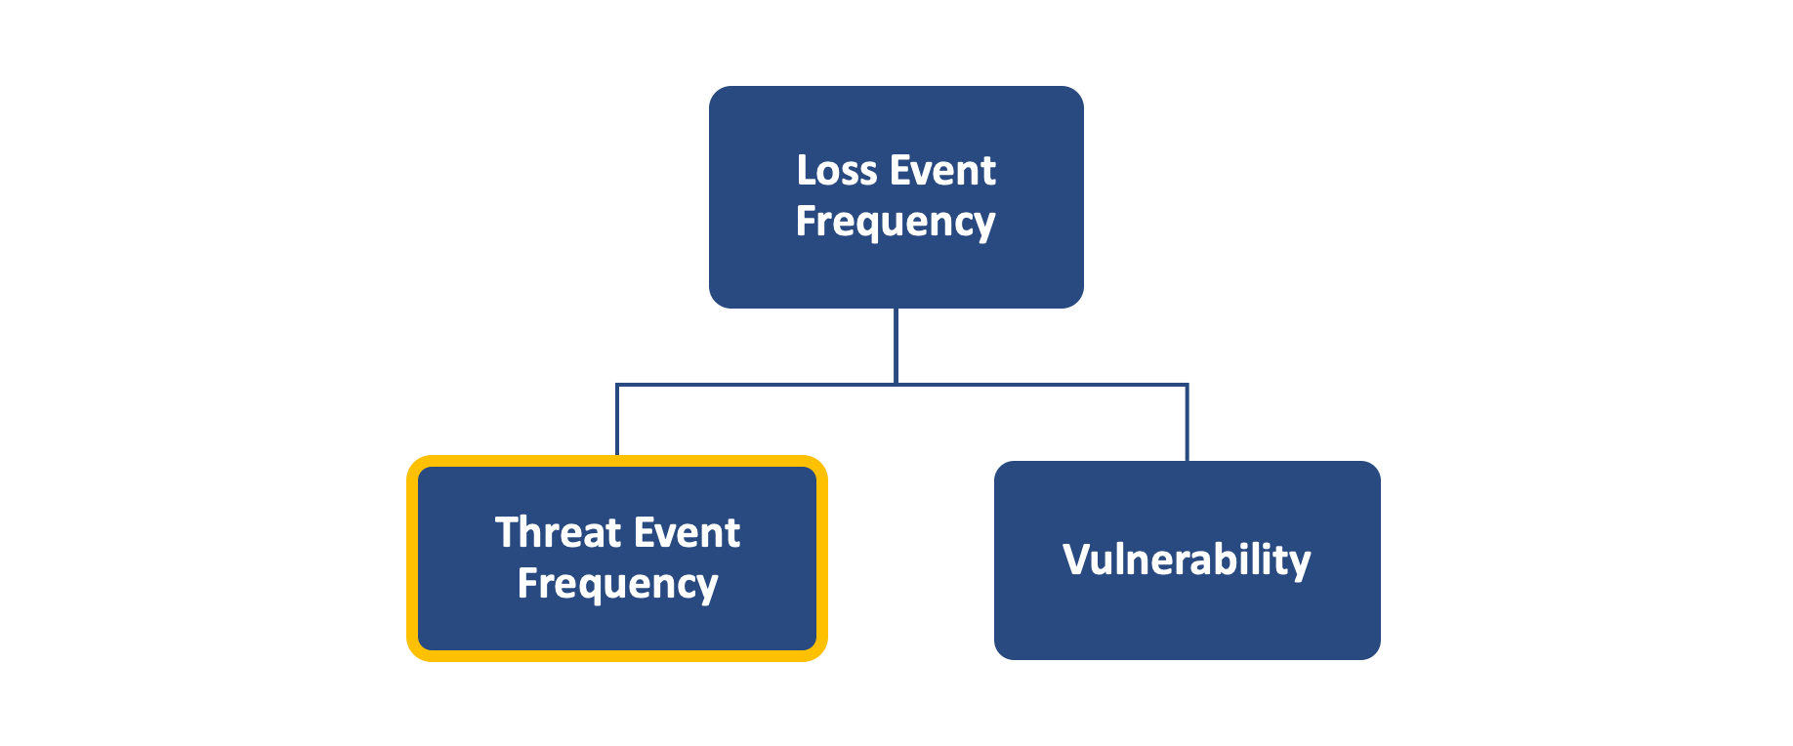
Threat Event Frequency (TEF)
“The probable frequency, within a given time-frame, that threat agents will act in a manner that may result in loss.”
In Contrast: Loss Event Frequency (LEF): “The probable frequency, within a given time-frame, that loss will materialize from a threat-agent’s action.”
TEF considers all actions taken by the threat agent, regardless if successful or not.
LEF considers only action taken by the threat agent that were successful i.e. resulted in a loss.
Notes:
Burglar targets your home 10 times per year --> Threat Event (he aborts before he can get in, he gets into the house but gets startled/runs away…still only a threat event).
2 times he might actually get in and steal something --> Loss Event

Slide 18
Threat Event Frequency (TEF)
Threat Event | Loss Event
Hacker attacking website. | Hacker damages site or steals information
Pushing new software release to production. | Release causes problem leading to downtime, data integrity issues etc.
Someone thrusting a knife at you | Getting cut in an attack with a knife
?
Can you thinks of other examples for Threat and Loss Events?
Notes:
Burglar targets your home 10 times per year --> Threat Event (he aborts before he can get in, he gets into the house but gets startled/runs away…still only a threat event).
2 times he might actually get in and steal something --> Loss Event

Slide 19
Vulnerability
Risk
Loss Event Frequency
Threat Event Frequency
Vulnerability
Loss Magnitude
Primary Loss
Secondary Risk
Secondary Loss Event Frequency
Secondary Loss Magnitude
Contact Frequency
Probability of Action
Threat Capability
Resistance Strength
Notes:
From the model we can infer that vulnerability is what will transform a Threat Event into a Loss Event.

Slide 20
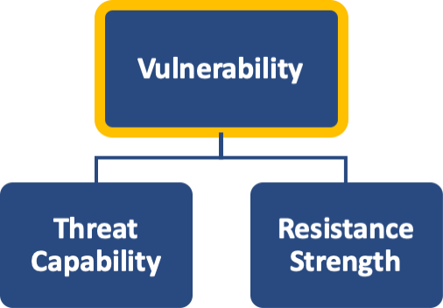
Vulnerability
“The probability that a threat agent’s actions
will result in loss.”
Expressed as a percentage.
The house is 100% vulnerable to damage from a tornado.
The lock is 100% vulnerable to compromise through lock-picking.
That password is 1% vulnerable to brute force attempts.
Usually expressed as a distribution:
That lock is between 5% to 20% vulnerable to lock-picking with a most likely value of 10%. (i.e. between 5% to 20% of lock picking attempts (most likely 10%) are estimated to be successful.

Slide 21
Vulnerability
Vulnerability exists when there is a difference between the Threat Capability and the difficulty to resist.
Vulnerability is evaluated in the context of the specific threat types and control types. For example the difficulty of overcoming anti-virus controls is irrelevant if the risk analysis is about insider fraud.

Slide 22
Threat Capability (TCap)
Risk
Loss Event Frequency
Threat Event Frequency
Vulnerability
Loss Magnitude
Primary Loss
Secondary Risk
Secondary Loss Event Frequency
Secondary Loss Magnitude
Contact Frequency
Probability of Action
Threat Capability
Difficulty
Notes:
The model is showing us that Vulnerability is a function of TCap and Difficulty.
TCap has to be higher than Difficulty to create a vulnerability.

Slide 23
Threat Capability (TCap)
Vulnerability
Threat Capability
Difficulty
“The capability of a threat agent.”
TCap is a matter of:
Skills i.e. knowledge and experience.
Resources i.e. time & material.
With natural threat agents it’s a matter of force.
!
Discuss the capabilities of Nation States, Hacktivists and Cyber Criminals in terms of skills and resources.

Slide 24
Threat Capability (TCap)
Vulnerability
Threat Capability
Difficulty
TCap is measured against the “TCap continuum”
i.e a percentiles scale from 1 to 100.
It represent the comprehensive range of capabilities for a population of threat agents.
Example: Least capable cyber criminal is at the 60th percentile, the most capable at the 100th and most are at approx. the 90th percentile.
We tend to focus on worst case, but that is thinking in terms of possibility not probability.

Slide 25
The TCap Continuum
We estimate the TCap of all threat agents/threat communities on the same scale called the TCap continuum.
40
50
65
Hacktivist
60
75
95
Cyber Criminals
80
90
98
Nation State
0%
20%
40%
60%
80%
100%

Slide 26
Resistance Strength
Risk
Loss Event Frequency
Threat Event Frequency
Vulnerability
Loss Magnitude
Primary Loss
Secondary Risk
Secondary Loss Event Frequency
Secondary Loss Magnitude
Contact Frequency
Probability of Action
Threat Capability
Resistance Strength

Slide 27

Resistance Strength
The official Open FAIR definition is:
“Resistance Strength (RS) is the strength of a control as compared to a baseline measure of force.”
However in “Measuring And Managing Information Risk” (the unofficial FAIR Reference) is is now referred to as:
“The level of difficulty that a threat agent must overcome.”
For sake of the Open FAIR Foundation exam you need to use “Resistance Strength”. For real life let’s stick with “Difficulty” because it’s less difficult to understand!

Slide 28
Resistance Strength = Difficulty
For sake of the Open FAIR Foundation exam you need to use “Resistance Strength”. For real life let’s stick with “Difficulty” because it’s less difficult to understand!
…Resistance strength was originally called “Control Strength”. CS and RS where found to be problematic definitions and that’s how we ended up with “Difficulty”.
Difficulty and TCap are used only in very rare risk analysis scenarios.
Did you
Know?

Slide 29
Resistance Strength (Difficulty)
“The level of difficulty that a threat agent must overcome.”
RS/Difficulty is measured against the TCap continuum, not against the specific threat community identified in the risk analysis scope.
Example:
An authentication control is expected to stop anyone below the 70th percentile along the TCap continuum. Anyone above the 90th percentile is certain to succeed. Most likely it’s effective only up to the 85th percentile.

Slide 30
Resistance Strength (Difficulty)
Relevant controls make the threat agent’s job more difficult (malicious or act-of-nature scenarios) or easier (in human error scenarios)
Examples:
Malicious Threat Agent | Human error | Acts of nature
Authentication | Training | Reinforced construction material
Access privileges | Documentation
Patching and Configuration | Process simplification
Encryption
Controls

Slide 31
Contact Frequency
Risk
Loss Event Frequency
Threat Event Frequency
Vulnerability
Loss Magnitude
Primary Loss
Secondary Risk
Secondary Loss Event Frequency
Secondary Loss Magnitude
Contact Frequency
Probability of Action
Threat Capability
Difficulty
?
By just looking at the model, can you guess what Contact Frequency and Probability of Action are about and how they contribute to Threat Event Frequency?

Slide 32
Contact Frequency (CF)
“The probable frequency, within a given time-frame, that threat agents will come into contact with assets.”
Contact Modes: Physical or Logical
Contact Types:
Random (tornado strike, flu…)
Regular (cleaning crew comes regularly at 5:15 PM…)
Intentional (burglar targets specific house)
Typically expressed as annualized distribution or as probability if it happens only once.

Slide 33
Probability of Action (PoA)
Risk
Loss Event Frequency
Threat Event Frequency
Vulnerability
Loss Magnitude
Primary Loss
Secondary Risk
Secondary Loss Event Frequency
Secondary Loss Magnitude
Contact Frequency
Probability of Action
Threat Capability
Difficulty

Slide 34
Probability of Action (PoA)
“The probability that a threat agent will act upon an asset once contact has occurred.”
PoA applies only to threat agents that can think, reason or otherwise make a decision (humans, animals..) but not acts of nature etc. (tornados).
Did you
People are deterred more by the likelihood of getting caught rather than the harshness of the punishment.
https://nij.gov/five-things/Pages/deterrence.aspx#note1
Know?
Notes:
Discuss how that “fun fact” might be useful in real life control design.
For example frequent auditing and sharing of results as demonstration that offenses are being detected can be useful.
Actually reviewing Logs and finding violations can be useful (instead of policies just stating a log review and no one ever reviews them).
The statements in policies like “violation can lead up to termination etc….” might not be as strong of a deterrent if people feel ”they can get away with it”

Slide 35
Probability of Action (PoA)
The choice to act is driven by:
Perceived value of the act from the threat agent’s perspective.
Perceived Level of effort and/or cost from the threat agent’s perspective.
Perceived Level of risk to the threat agent.
!
Discuss how PoA might be reflected in different Threat Communities.
Notes:
People are deterred by the likelihood of getting caught rather than the harshness of the punishment.

Slide 36
Probability of Action (PoA)
Risk
Loss Event Frequency
Threat Event Frequency
Vulnerability
Loss Magnitude
Primary Loss
Secondary Risk
Secondary Loss Event Frequency
Secondary Loss Magnitude
Contact Frequency
Probability of Action
Threat Capability
Difficulty

Slide 37
Loss Magnitude
“The probable magnitude of primary and secondary loss resulting from an event.”
Simply: how much tangible loss is expected to materialize from an event.
Distinguishing between primary and secondary loss is based on stakeholders and and analysis perspective.

Slide 38
Loss Magnitude
Primary stakeholders are those individuals or organizations whose perspective is the focus of the risk analysis. Usually the owner of the primary asset in the risk scenario.
Secondary stakeholder is anyone who is not a primary stakeholder that may be affected by the loss event being analyzed, and then may react in a manner that harms the primary stakeholder.

Slide 39
Loss Magnitude
Example
Company X (primary stakeholder) has an event that damages public health. Direct losses incurred like cleanup are primary losses.
The public (secondary stakeholder) reacts negatively through legal action, protests, taking business else where etc. these are secondary losses.

Slide 40
Loss Magnitude
Losses incurred by the secondary stakeholder are not put into the formula (not directly). We would, if these losses are transferred to the primary stakeholder.
For example company X might have to compensate members of the community. These would be included in the secondary loss component.
We can always do a separate risk analysis from the public’s perspective if that were useful.
Notes:
For example you would need to know secondary stakeholders losses because you have to compensate based on that value.
Pay for claims etc.

Slide 41
Primary Loss Magnitude
“Primary stakeholder loss that materializes directly as a result of the event.”
Examples:
Lost revenue from operational outages
Wages paid to workers when no work is being performed due to an outage
Replacement of the organization’s tangible assets
Person-hours restoring functionality to assets or operations following an event
Controls Examples:
Disaster Recovery, Business Continuity processes and technologies
Incident response processes
Process or technology redundancies

Slide 42
Forms of Loss
FAIR decomposes loss into the following six categories
Productivity
Response
Replacement
Competitive Advantage
Fines and Judgments
Reputation

Slide 43
Forms of Loss
Productivity | Losses resulting from org. ability to execute on its primary value proposition. (revenue lost when retail website goes down) Losses resulting from personnel being paid but unable to perform their duties. (Failure in call center) Consider if revenue is really lost or simply delayed. Can the revenue be recovered? Are all activities of the personnel effected by they failure?
Response | Costs associated with managing the loss event. For example incident response team costs. Secondary Response costs (expenses incurred dealing with secondary stakeholder) like notification and credit monitoring costs (confidential records breach)
Replacement | The intrinsic value of the asset. The cost to replace the physical asset. Secondary replacement costs: Refund stolen funds. Replacing credit cards after a credit card information breach.

Slide 44
Forms of Loss
Competitive Advantage | Losses focused on some asset (physical or logical) that provide an advantage over the competition. Something another company cannot acquire or develop (legally) on their own (like intellectual property, secret business plans, market information, patent, copyrights, trade secrets).
Fines and Judgments | Regulatorily fines, class action law suits
Reputation | Effects of reputation loss: market share, cost of capital, stock price, increased cost hiring/retaining employees. Reputation losses occur because of a secondary stakeholder perception that and organization’s value has decreased or liability has increase that affects stakeholders.

Slide 45
Typical Loss Type Mapping
Loss Type | Primary Loss | Secondary Loss
Productivity | ✭
Replacement | ✭
Response | ✭ | ✭
Competitive Advantage |  | ✭
Reputation |  | ✭
Fines and Judgements |  | ✭

Slide 46
Secondary Risk
Risk
Loss Event Frequency
Threat Event Frequency
Vulnerability
Loss Magnitude
Primary Loss
Secondary Risk
Secondary Loss Event Frequency
Secondary Loss Magnitude
Contact Frequency
Probability of Action
Threat Capability
Difficulty

Slide 47
Secondary Risk
“Primary stakeholder loss-exposure that exists due to the potential for secondary stakeholder reactions to primary event.”
Think of it as the fallout from the primary event.
Or another way to look at it is that primary losses identified in a risk scenario will always be incurred in each loss event (in the estimated range of loss magnitude). Secondary losses will occur only in some of the loss events (in the estimated range of loss magnitude) and not at all in others.

Slide 48
Secondary Risk
Risk
Loss Event Frequency
Threat Event Frequency
Vulnerability
Loss Magnitude
Primary Loss
Secondary Risk
Secondary Loss Event Frequency
Secondary Loss Magnitude
Contact Frequency
Probability of Action
Threat Capability
Difficulty

Slide 49
Secondary Loss Event Frequency (SLEF)
“The percentage of primary events that have secondary effects.”
Company X has environmental loss event of 10 times per year. Secondary losses materialize only 20% of the time i.e. SLEF is 2 times per year.
Secondary Loss Magnitude
“Loss associated with secondary stakeholder reactions.”
Examples: Civil, criminal or contractual fines and judgments, notification costs, public relation costs, legal defense costs, effects of regulatory sanctions, lost market share, diminished stock price, increased cost of capital….

Slide 50
FAIR and Control Categories
FAIR considers four main control categories
Avoidance Controls
Deterrent Controls
Vulnerability Controls
Responsive Controls

Slide 51
Vulnerability Controls
Affect the probability that a threat’s action will result in loss
Responsive Controls
Affect the amount of loss that result from a threat’s action
Avoidance Controls
Affect the frequency and/or likelihood of encountering threats
Deterrent Controls
Affect the likelihood of a threat acting in a manner that can result in harm
Risk
Loss Event Frequency
Threat Event Frequency
Vulnerability
Loss Magnitude
Primary Loss
Secondary Risk
Secondary Loss Event Frequency
Secondary Loss Magnitude
Contact Frequency
Probability of Action
Threat Capability
Difficulty

Slide 52
Risk
Loss Event Frequency
Threat Event Frequency
Vulnerability
Loss Magnitude
Primary Loss
Secondary Risk
Secondary Loss Event Frequency
Secondary Loss Magnitude
Contact Frequency
Probability of Action
Threat Capability
Difficulty
Responsive
Vulnerability
Avoidance
Deterrent

Slide 53
Avoidance Controls
These controls try to reduce the frequency and/or likelihood that the threat gets into contact with the asset. For example:
Firewalls
Network Segmentation
2FA
Physical Barriers
Application Isolation
Data Loss Prevention
Segregation of Duties

Slide 54
Deterrent Controls
These controls reduce the probability tat a threat agent will act against the asset in a manner that may result in loss.
The controls work at the Probability of Action level. We mentioned earlier that PoA is a function of:
Perceived value of the act from the threat agent’s perspective.
Perceived Level of effort and/or cost from the threat agent’s perspective.
Perceived Level of risk to the threat agent.

Slide 55
Deterrent Controls
Value of the act from the threat agent’s perspective.
Perceived Level of effort and/or cost from the threat agent’s perspective.
Perceived Level of risk to the threat agent.
We probably can’t do much to reduce the perception of value from the threat agent’s perspective, however we can:
Force the threat to having to invest more effort and thus increasing cost.
We can increase the level of risk to the threat agent.

Slide 56
Deterrent Controls
Logging and Monitoring
Asset hardening
Defense in depth
Deception Technologies
Physical obstacles

Slide 57
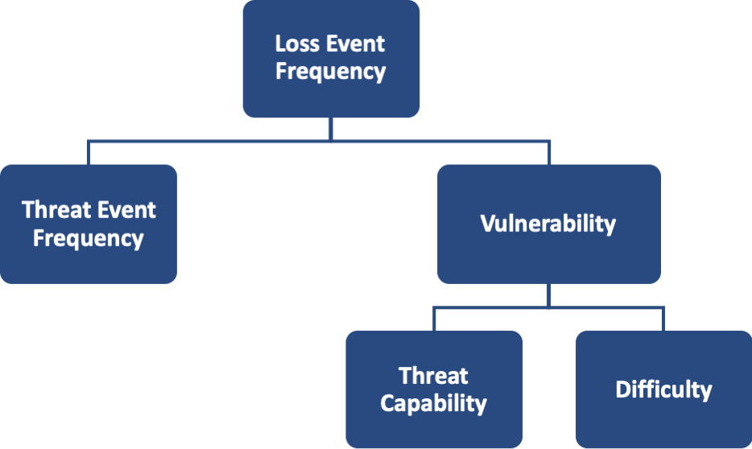
Vulnerability Controls
These controls reduce the probability that threat events will become loss events. We become less vulnerable when our resistance strengths exceeds the threat’s capabilities.
When the threat action is malicious we focus on making it more difficult to the threat agent to cause harm.
When the threat action is non-malicious like human error we focus on making it easier for the threat agent to comply and adhere to expected behavior.

Slide 58
Vulnerability Controls
Vulnerability Management
Source Code Review
Patch Management
Deception Technology
Isolation and Segmentation
Honeypot
SIEM
Anomaly Detection
CCTV

Slide 59
Response Controls
These are controls focusing on reducing the loss magnitude after a loss event has taken place.
Backup and Restore
Disaster Recovery Plans
Incident Retainer
Data Segmentation
Network Segmentation
Log monitoring

Slide 60
Last words on controls
Some controls can work on different levels. For example network segmentation can make it difficult for the threat agent to move from a low security segment into a high security segment where the crown jewels are located (Avoidance Control). But it could also limit the loss to a particular segment for example a worm outbreak could be limited to a particular segment (Response Control).
Detective Controls: FAIR does not consider it a distinct control category. For example logs can be a “detective control” but can also be a deterrent (for insiders) and can be a trigger to respond earlier to an ongoing event.

Slide 61
Last words on controls
When thinking about treatment plans just remember that there are probably multiple options to treat the risks. One option might be better than the other, or maybe you will even need a combination of different controls.

Slide 62
?
Can you fill in the blanks?
Risk
Notes:
Print this out and give to the students to each fill it out from memory. Encourage them to use logic and reasoning. It’s OK if they don’t get terminology 100% correct.

Slide 63
Conclusion
You are now familiar with the FAIR model and the control categorization.
For the Open FAIR exam you must be able to draw the model from memory and know and understand the terminology.
In the next Module we will focus on scoping a risk analysis.

